Slide 1
Healthcare Analysis
Group : 5

Slide 2
Group Members
Pratiksha
Shalini
Sushant
Rithik
Solone
Tabassum Shah

Slide 3


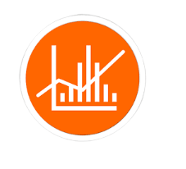
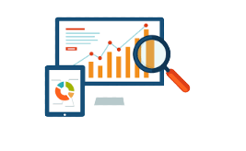
Agenda
Introduction & Problem Statement
Dashboard
Business
objective
KPI’S
Problem Statement
Analytical Tools
Number Of Patients Across Various Summaries
Profit Vs Non-profit Stats
Chain Organizations w.r.t. Total Performance Score as No Score
Dialysis Stations Stats
Average Payment Reduction Rate
# Of Category Text - As Expected
Excel
MySQL
PowerBI
Tableau
PPT for editing and presentations

Slide 4
Introduction
Dialysis healthcare analytics involves the analysis of key performance indicators (KPIs) to gain insights and make data-driven decisions in the field of dialysis care.
By leveraging these analytics, healthcare providers can optimize care delivery, improve operational efficiency, enhance financial performance, and ultimately improve patient outcomes in the dialysis care sector.

Slide 5

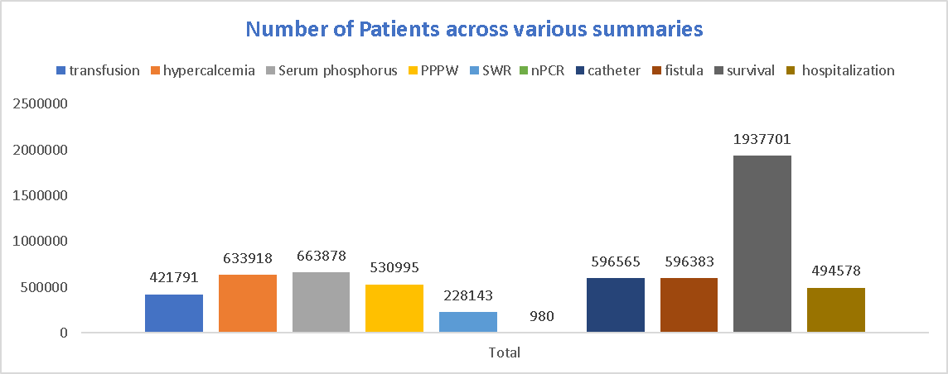
NUMBER OF PATIENTS ACROSS VARIOUS SUMMARIES
It involves tracking the patient population trends, such as the total number of patients, patient demographics, and specific patient summaries.
This KPI provides insights into the demand for dialysis services, helps in capacity planning, and assists healthcare providers in delivering personalized care based on patient characteristics

Slide 6
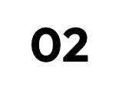
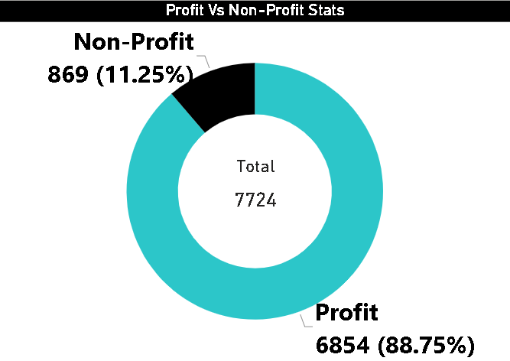
PROFIT VS NON-PROFIT STATS
Comparing the financial performance of profit- driven and non-profit organizations is an important aspect of
healthcare analytics.
It helps identify the differences in financial outcomes between profit and non-profit organizations and enables stakeholders to make Informed decisions regarding resource allocation, cost management, and sustainability of care.

Slide 7
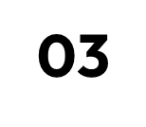
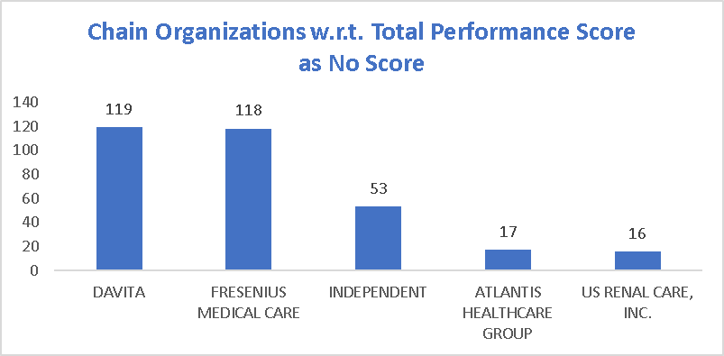
CHAIN ORGANIZATIONS W.R.T. TOTAL PERFORMANCE SCORE AS NO SCORE
The total performance score evaluates various quality measures, patient outcomes, and adherence to best practices.
By analyzing chain organizations in terms of their total performance score, healthcare providers can identify areas of improvement, benchmark against industry standards, and promote quality care delivery across different chains.

Slide 8

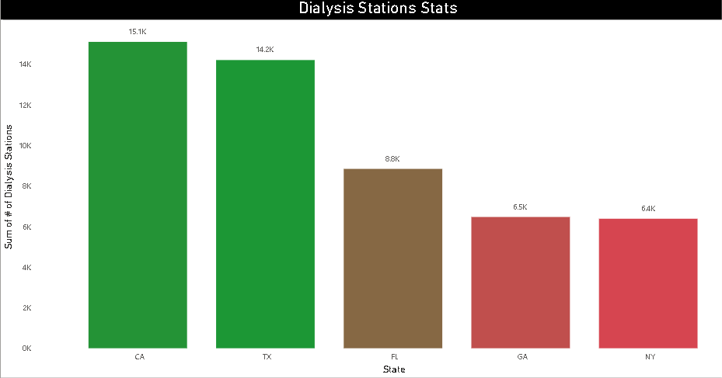
DIALYSIS STATIONS STATS
This involves tracking the number of dialysis stations, their utilization rates, availability, and efficiency of operations.
By analyzing these statistics, healthcare providers can optimize resource allocation, identify areas of underutilization or overcrowding, ensure equitable access to dialysis services, and improve overall operational efficiency in delivering care.

Slide 9
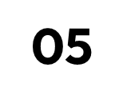
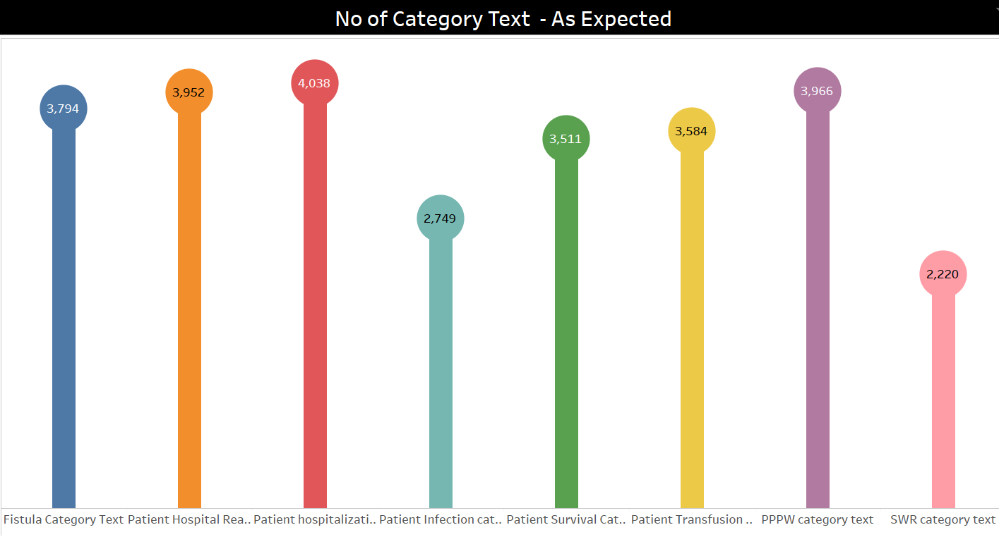
# OF CATEGORY TEXT - AS EXPECTED
It involves categorizing patients based on specific criteria and examining their outcomes.
By comparing these outcomes with expectations, healthcare providers can assess the effectiveness of different treatment plans, identify patterns, and tailor care strategies to specific patient categories, ultimately improving the quality of care provided

Slide 10

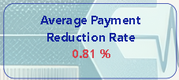
AVERAGE PAYMENT REDUCTION RATE
It measures the rate at which payments for dialysis services are reduced, such as throug adjustments or contractual agreements.
By analyzing this KPI, healthcare providers can assess their financial performance, identify factors contributing to payment reductions, and develop strategies to mitigate the impact on revenue while maintaining high-quality care standards.

Slide 11
What we learn
Importance of Key Performance indicator in data Analytics.
Parameters to be assessed after Dialysis of Patients
e.g. Number of Patients across various summaries
Profit Vs Non-Profit Stats ,Dialysis Stations Stats,# of Category Text - As Expected, etc.
How all these parameters are extracted from data to make pivot tables, charts and beautify interactive and mesmerizing dashboards in Excel, Power Bi and Tableau using slicers, filters, icons and images. Writing queries for the same in SQL.

Slide 12
Challenges During Project
True challenge was to assemble our classroom knowledge and to put it into this real-world.
Different opinions and priorities to be gathered as a team for each tasks.
Compiling and selecting the best outcomes for presentation.

Slide 13
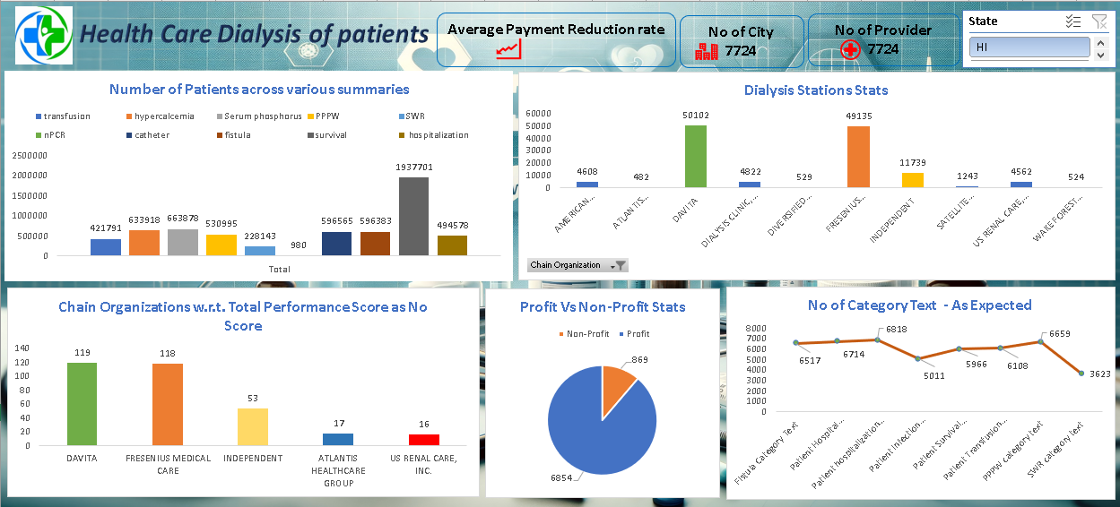
Excel Dashboard

Slide 14
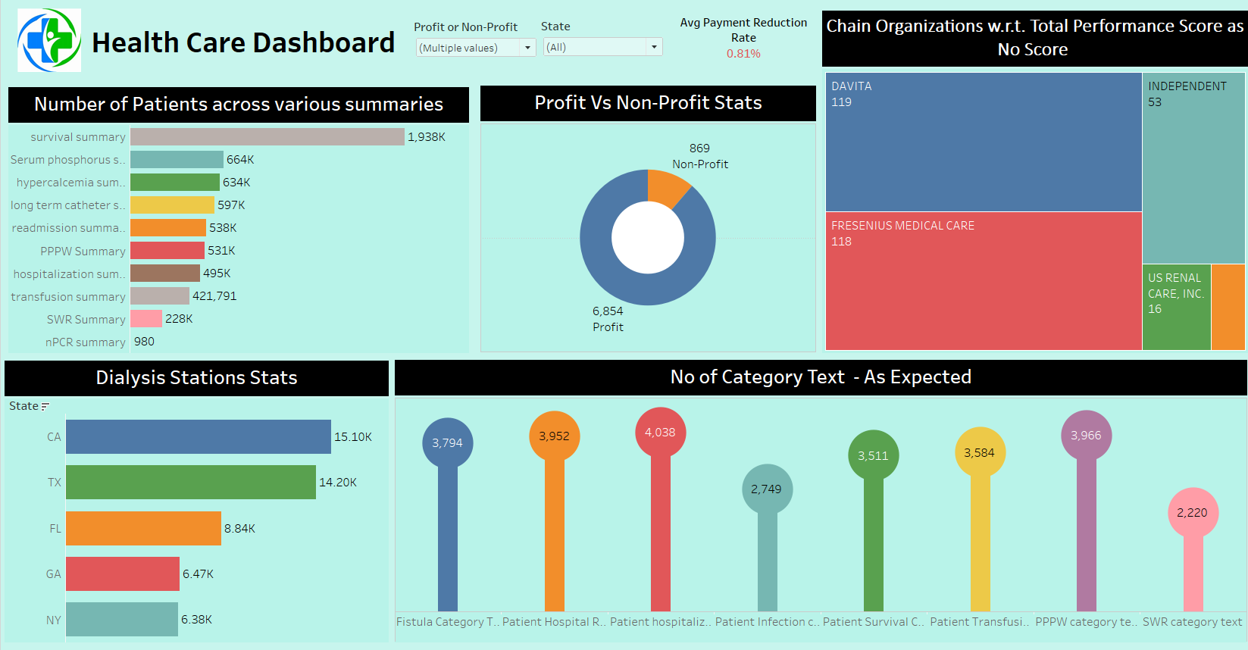
Tableau Dashboard

Slide 15
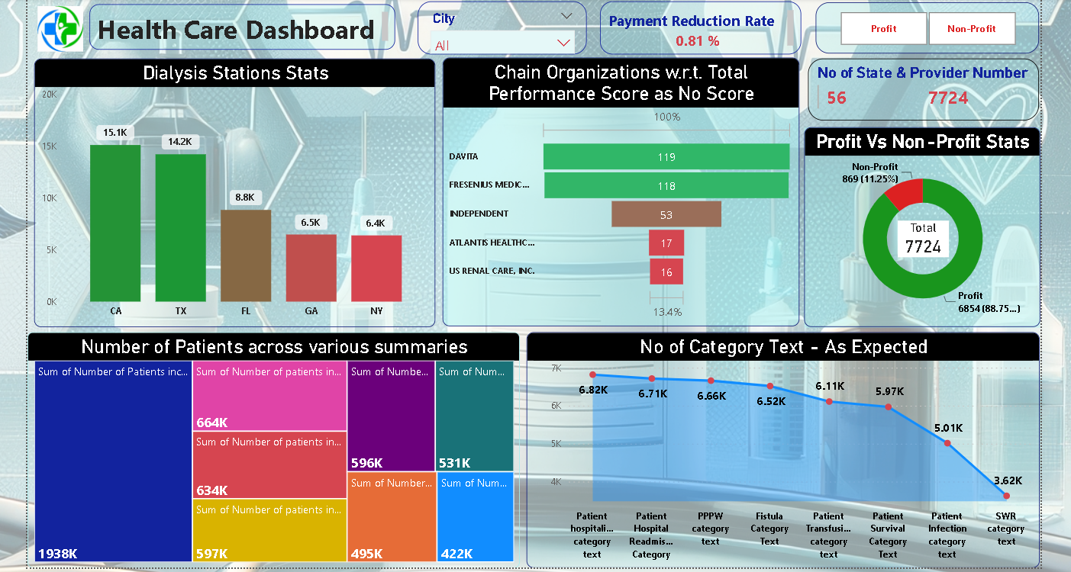
PowerBI Dashboard

Slide 16


Thanks!

